Slide 1
Trade Promo Analysis
Springboard Project
Case Study
Confidential
28-DEC-2023
Fazil & Upasana

Slide 2
01
EDA

Slide 3
Exploratory Data Analysis
Objective: Visualize the Relationship between Independent Variables and Volume Sales (Vol. Sales)

Slide 4
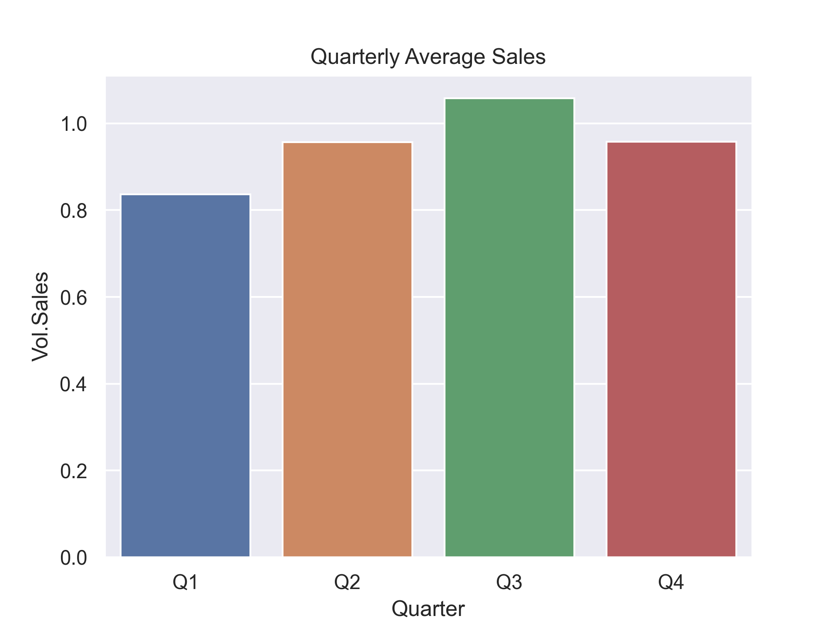
Sales performance on quarterly basis
Insights
｜
There are no huge fluctuations in the average sales. Though we can see that Q3 has the highest sales on average.

Slide 5
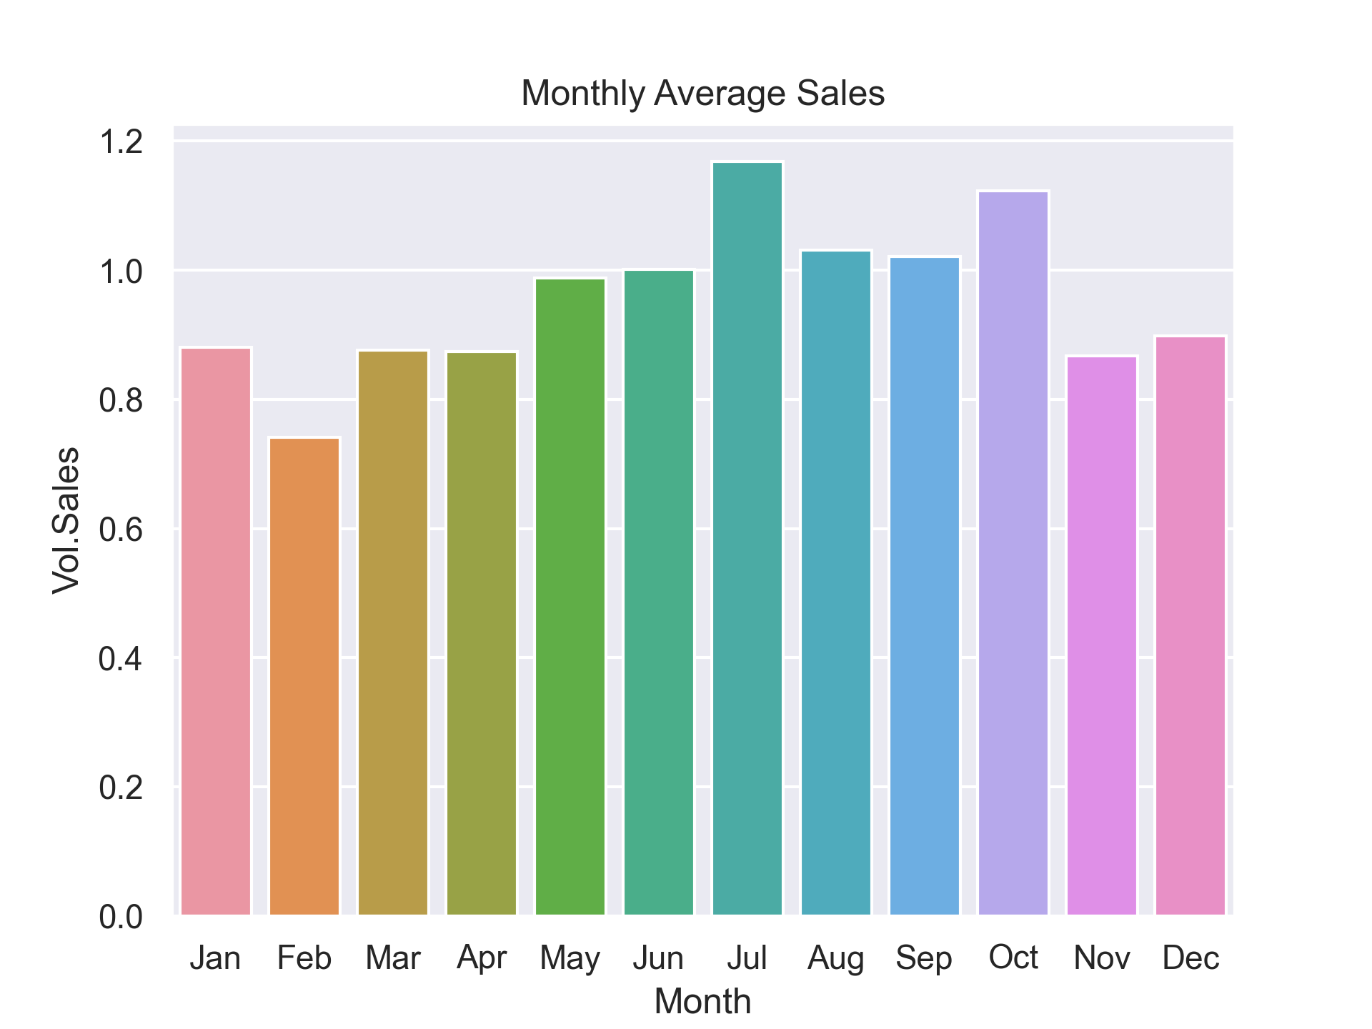
Sales performance on monthly basis
Insights
｜
July and October has the highest sales and February has the lowest. There is not much variance in the rest of the months

Slide 6
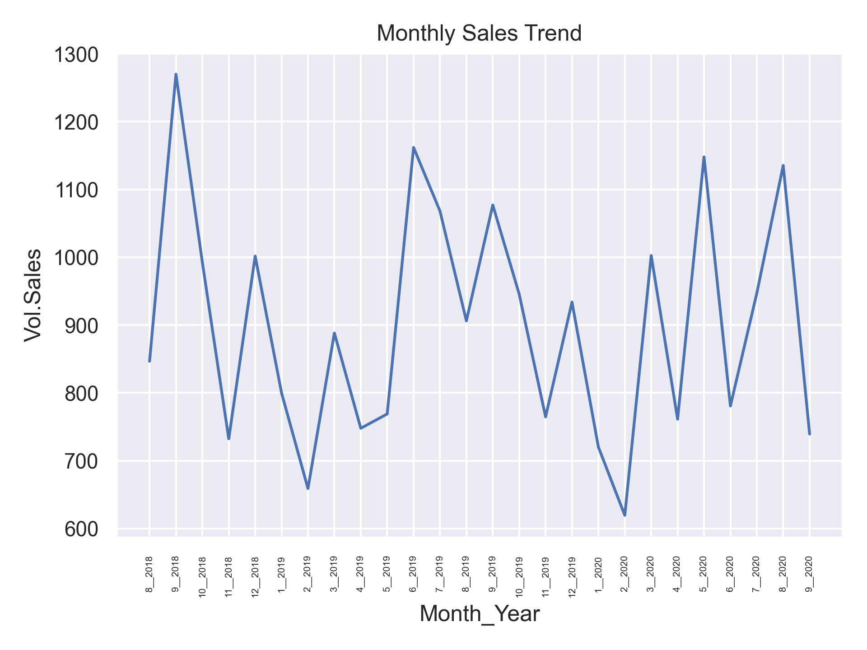
Monthly sales trend
Insights
｜
Seasonal pattern in the sales trend in evident from this plot. We have a big peak followed by two smaller peaks

Slide 7
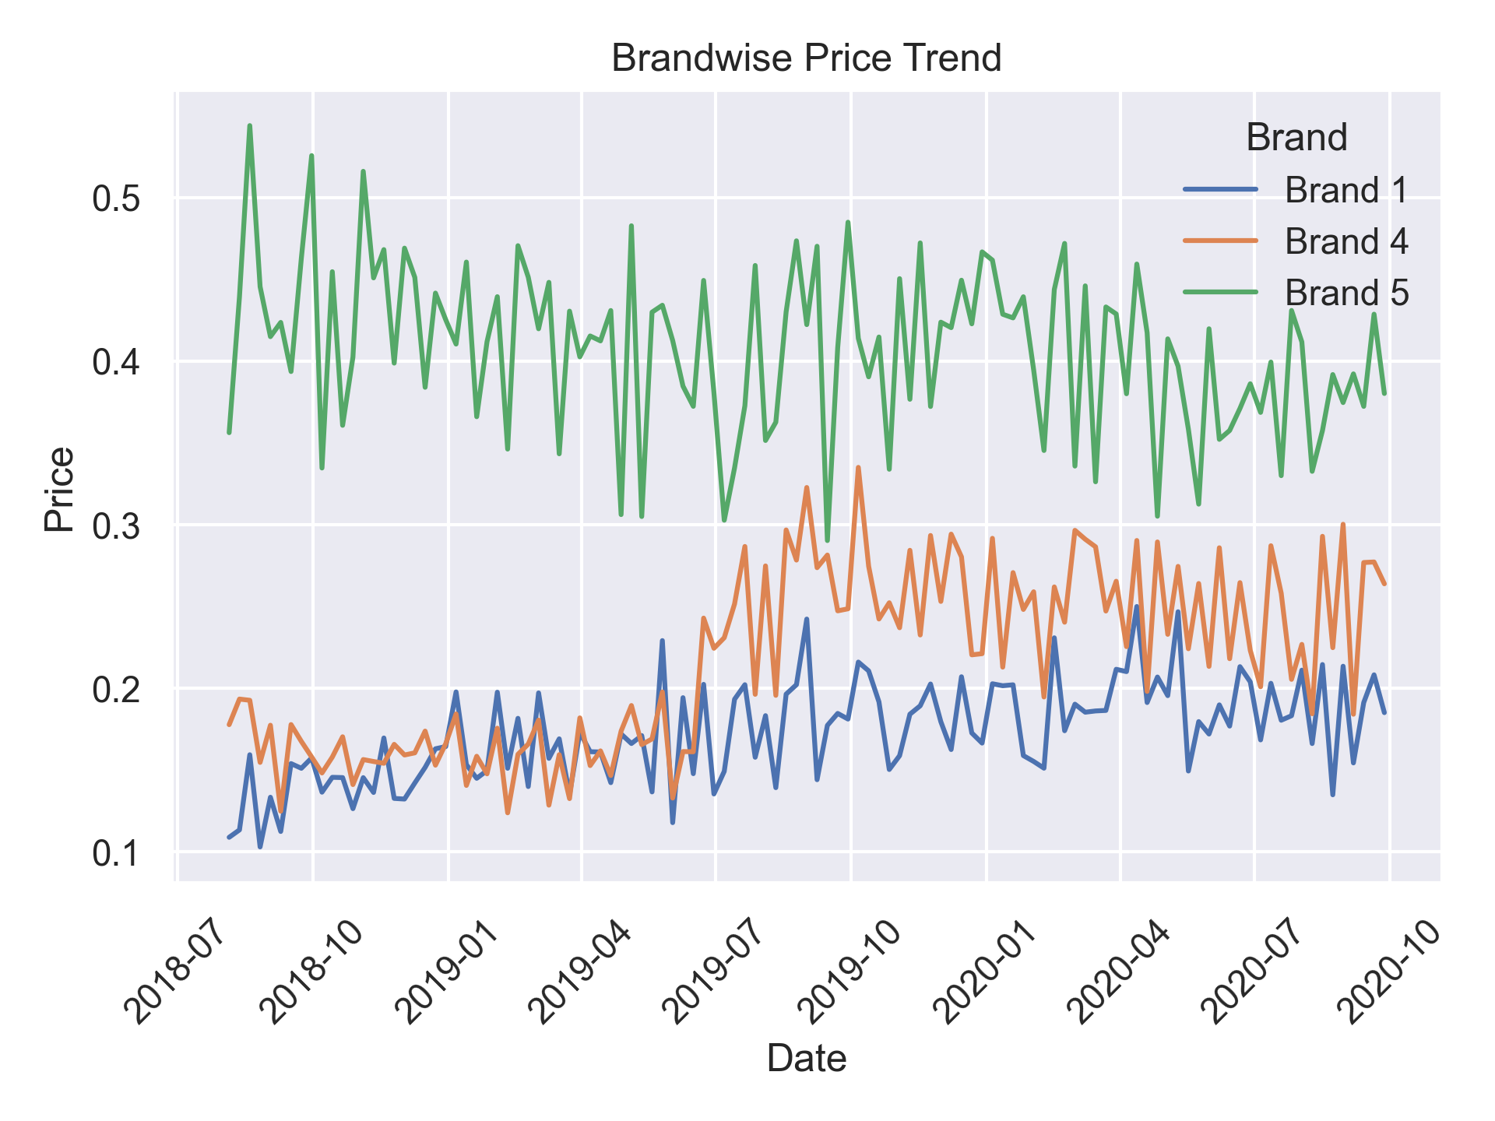
Brand-wise price trend
Insights
｜
Brand5 is the dominant brand. Brand4 and Brand1 started out on same level, later on Brand4 took off and became more expensive than Brand1

Slide 8
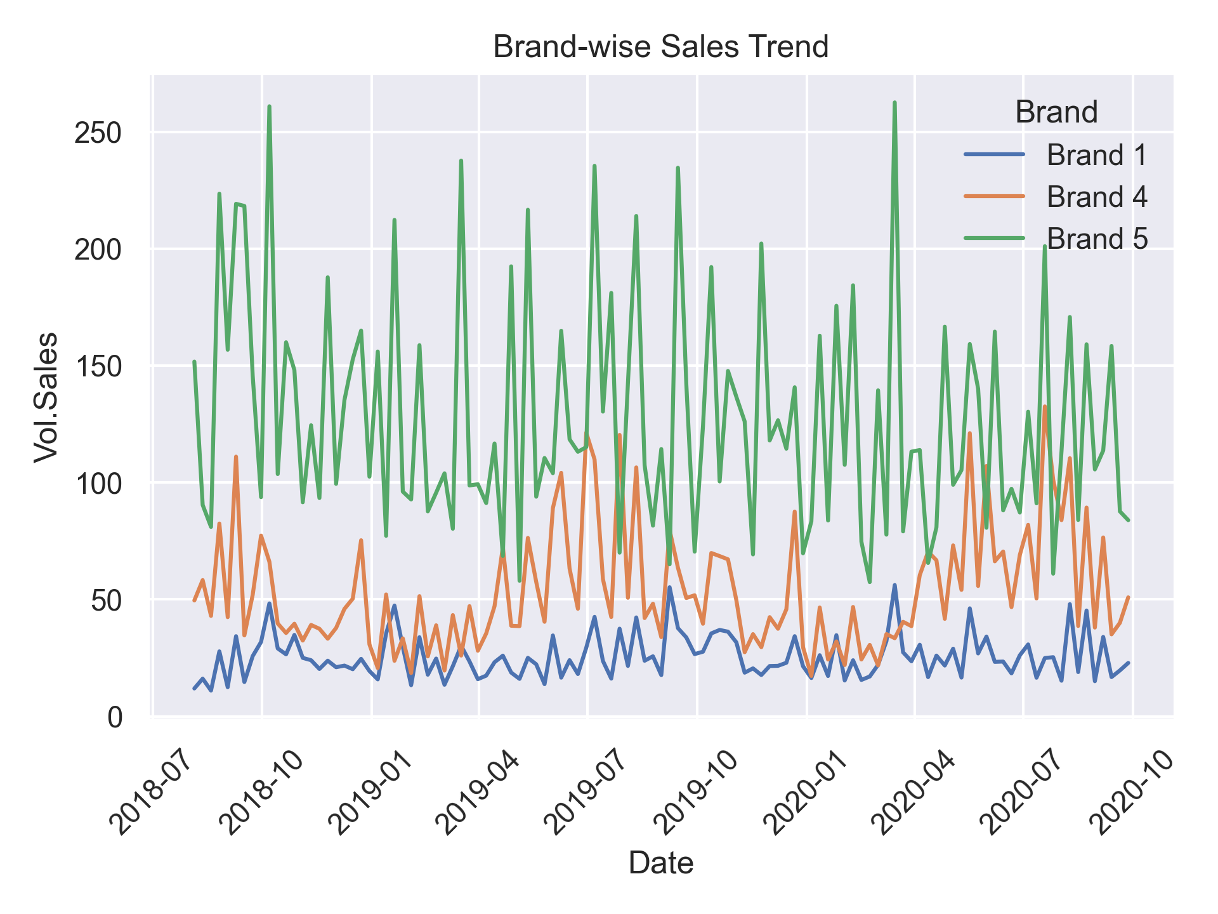
Brand-wise sales trend
Insights
｜
Brand5 is the dominant brand in terms of sales too, followed by Brand4 and Brand1 in the same order. All 3 line graphs exhibit some degree of cyclic pattern

Slide 9
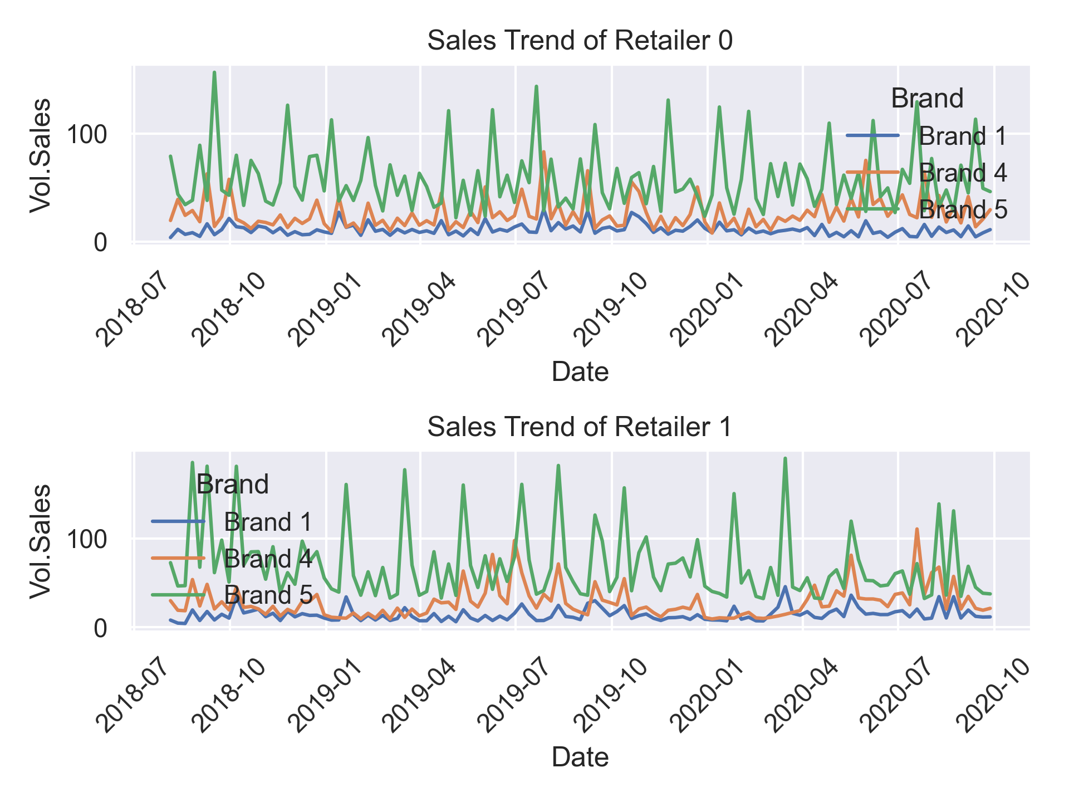
Retailer x Brand-wise sales trend
Insights
｜
Retailer-wise brand sales trend is quite similar to the undivided brand sales trend

Slide 10
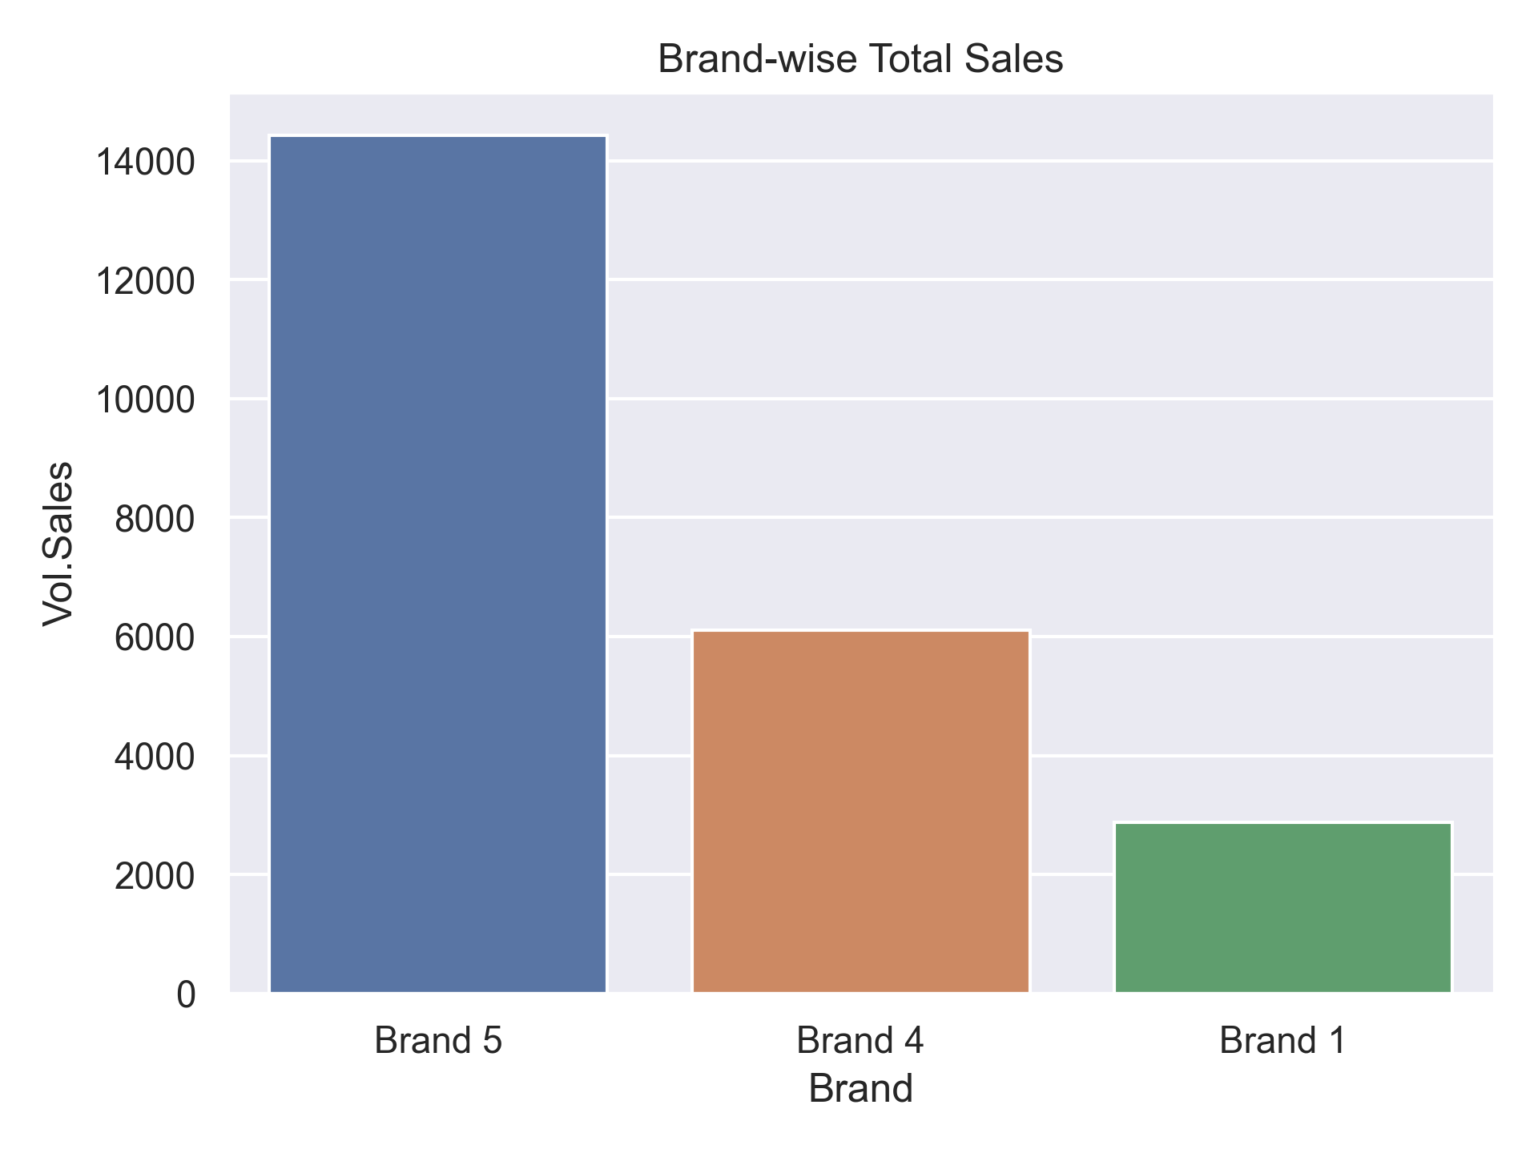
Sales performance of brands
Insights
｜
As the sales trend already revealed, Brand5 is the fastest moving brand. Sales of Brand5 alone is 1.5 times greater than the other two brands combined

Slide 11
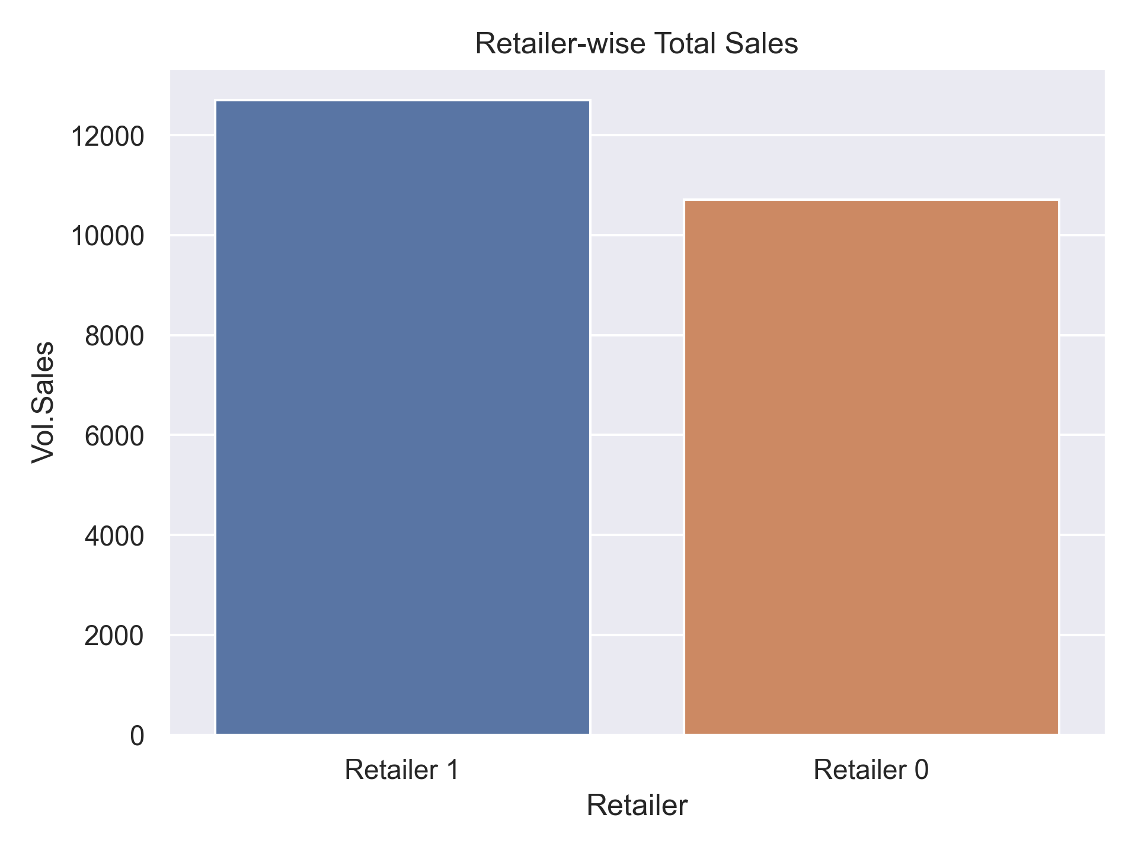
Sales performance of retailers
Insights
｜
Retailer1 has more sales than Retailer0. The difference is not staggering though.

Slide 12
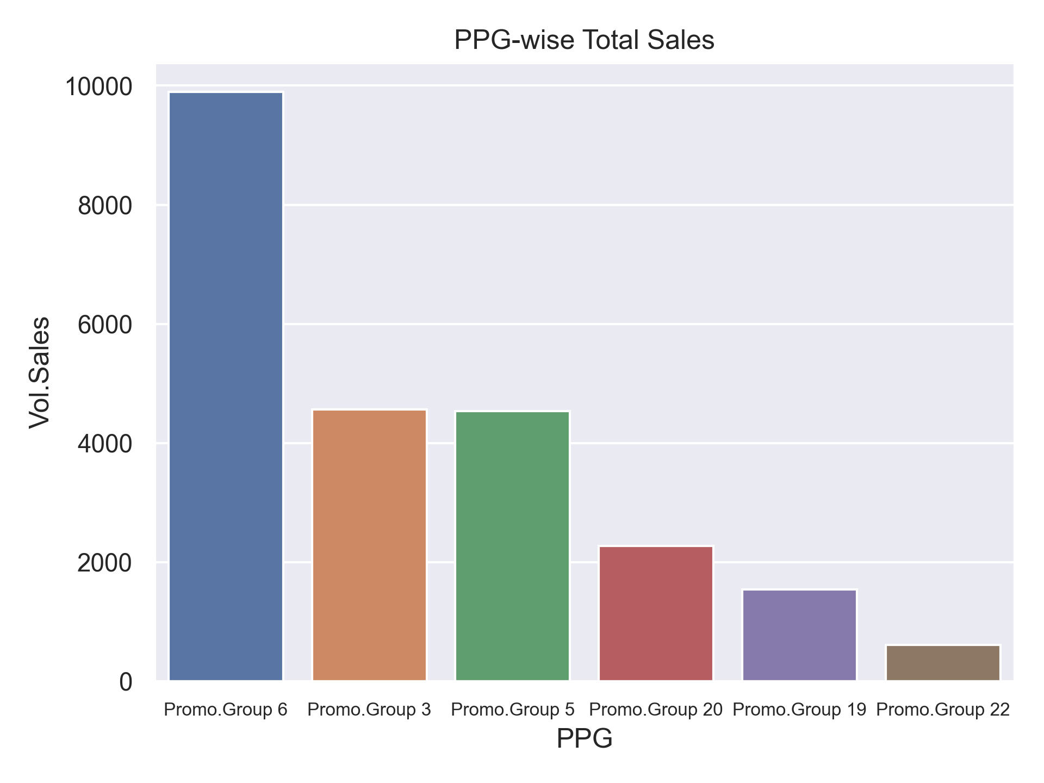
Sales performance of PPGs
Insights
｜
Promo.Group6 is significantly greater than all other PPGs. In fact, it is almost same as remaining all other PPGs combined

Slide 13
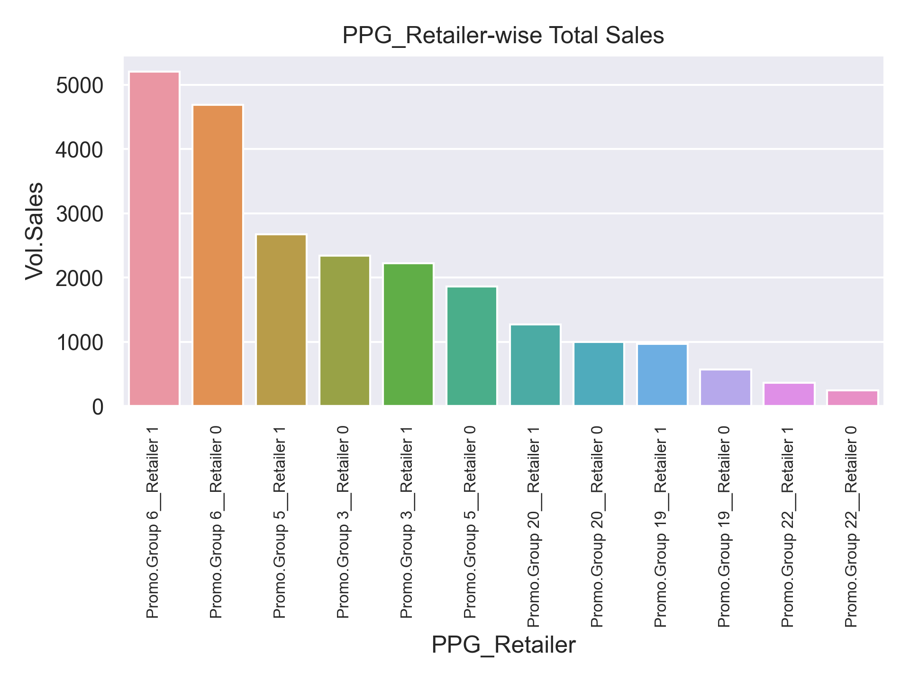
Sales performance of PPG x Retailer combinations
Insights
｜
Retailerwise breakup of the previous plot. Almost follows the same trend as the previous plot

Slide 14
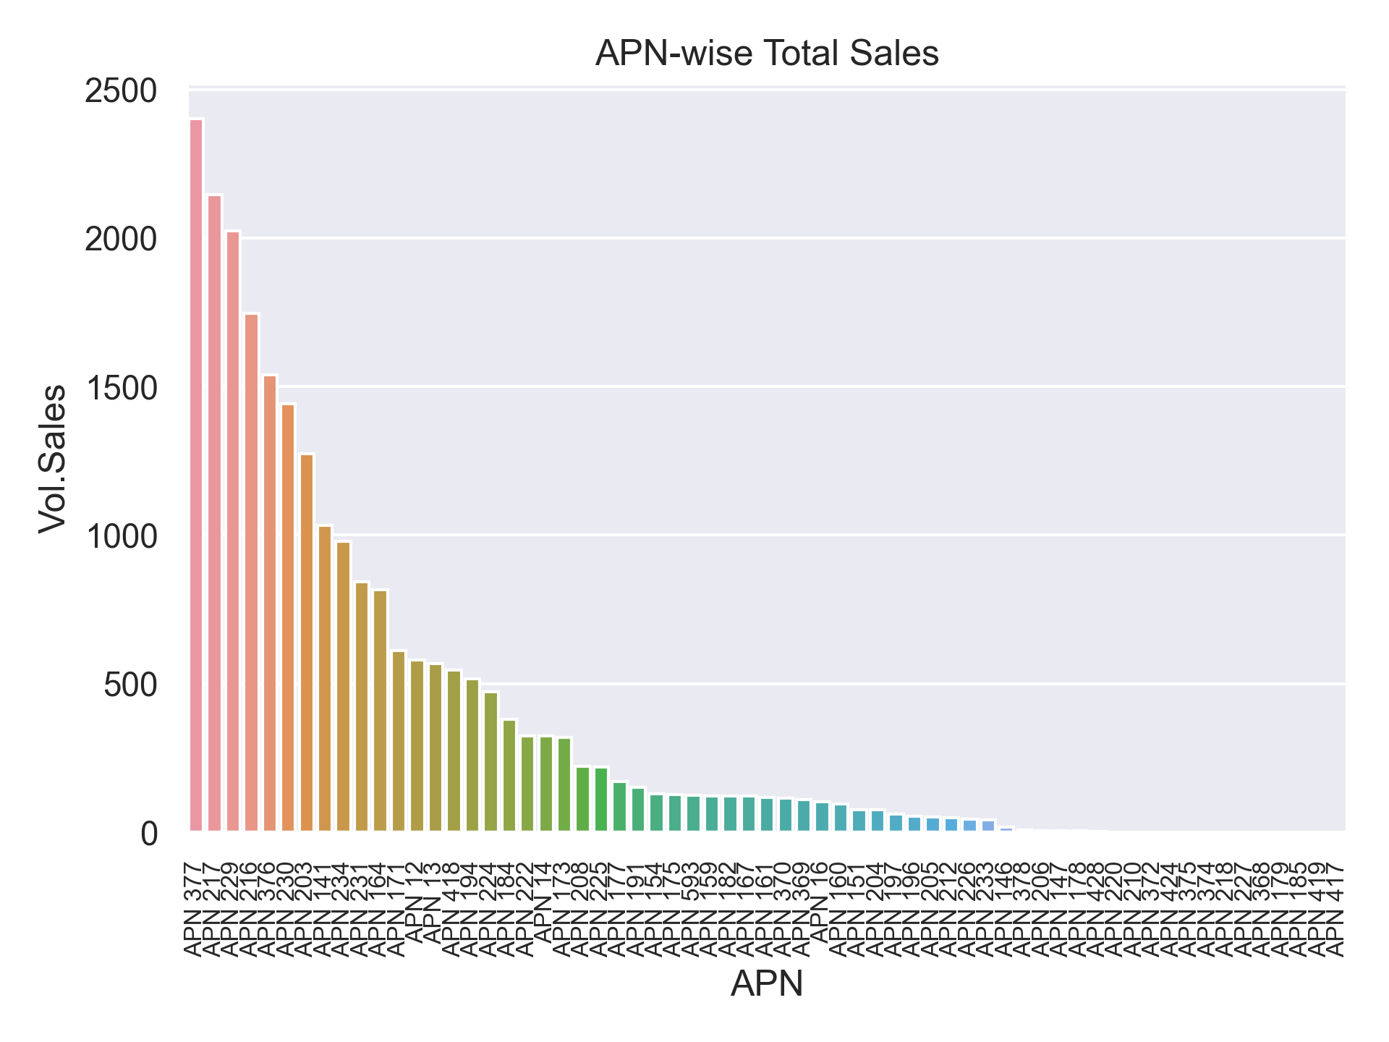
Sales performance of APNs
Insights
｜
APNs are essentially items and their sales volume closely resembles a power law distribution

Slide 15
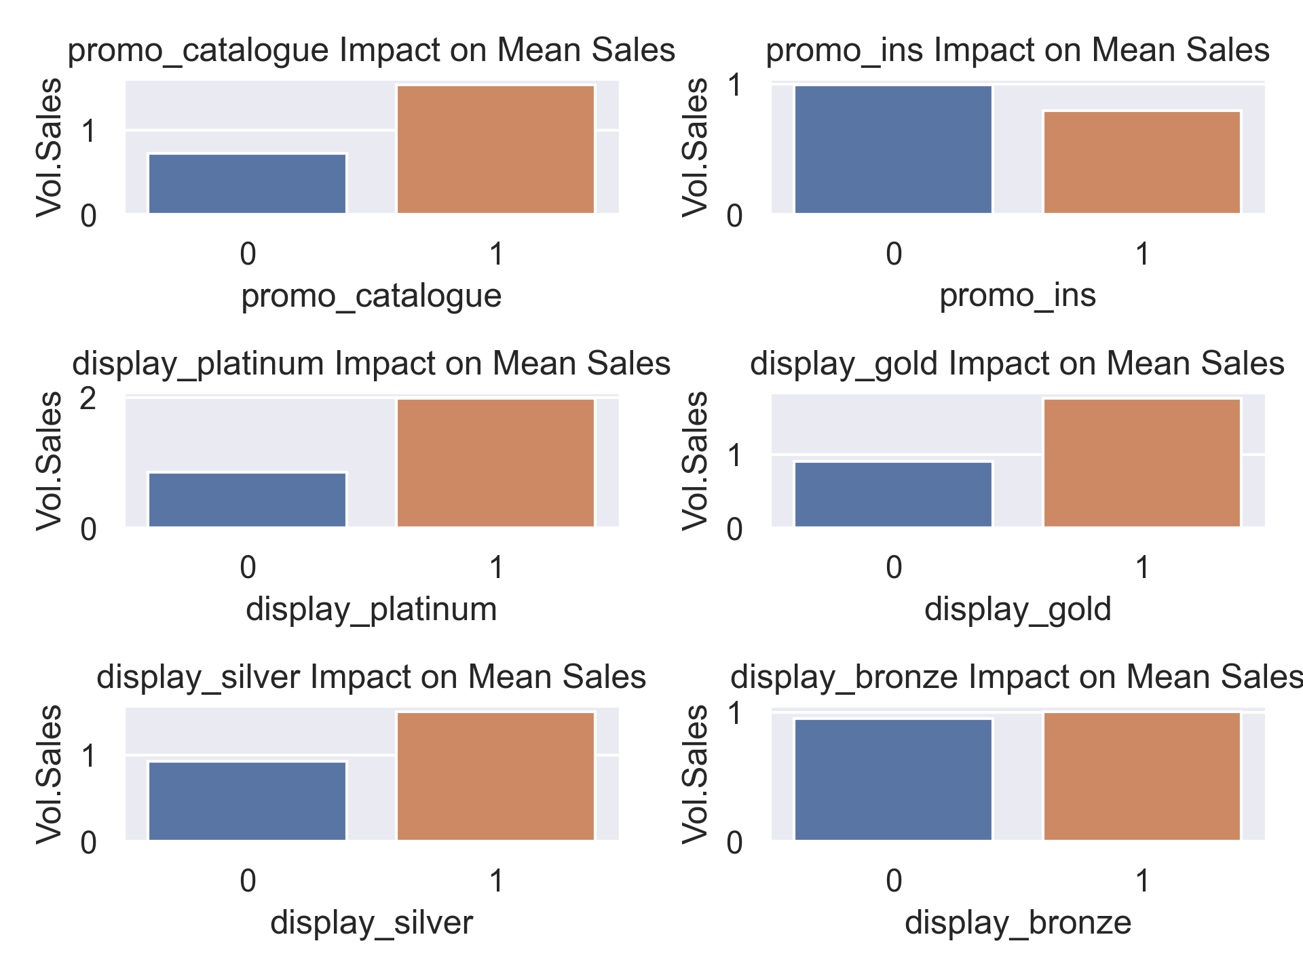
Impact of promotional activities on average sales
Insights
｜
There are 2 promos and 4 displays, as we expected, running these promotional activities increases the average sales with an only exception of promo_ins

Slide 16
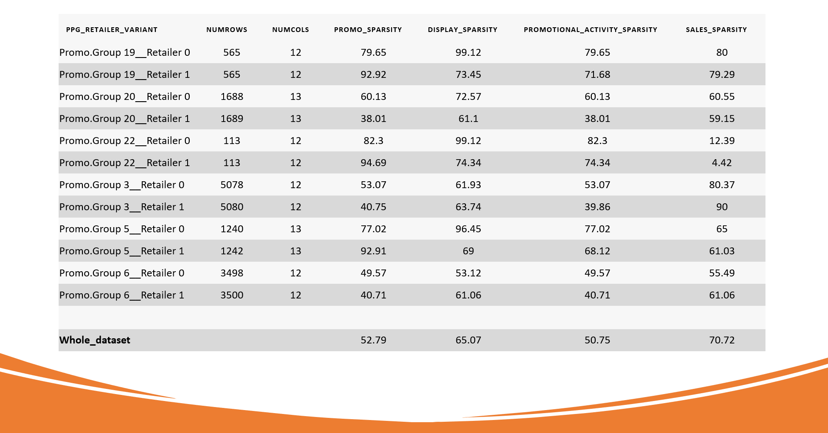
Sparsity analysis

Slide 17
02
Model Performance

Slide 18
Model Metrics
Objective: Visualize the r2 score on train and test data for the models built for different PPG x Retailers

Slide 19
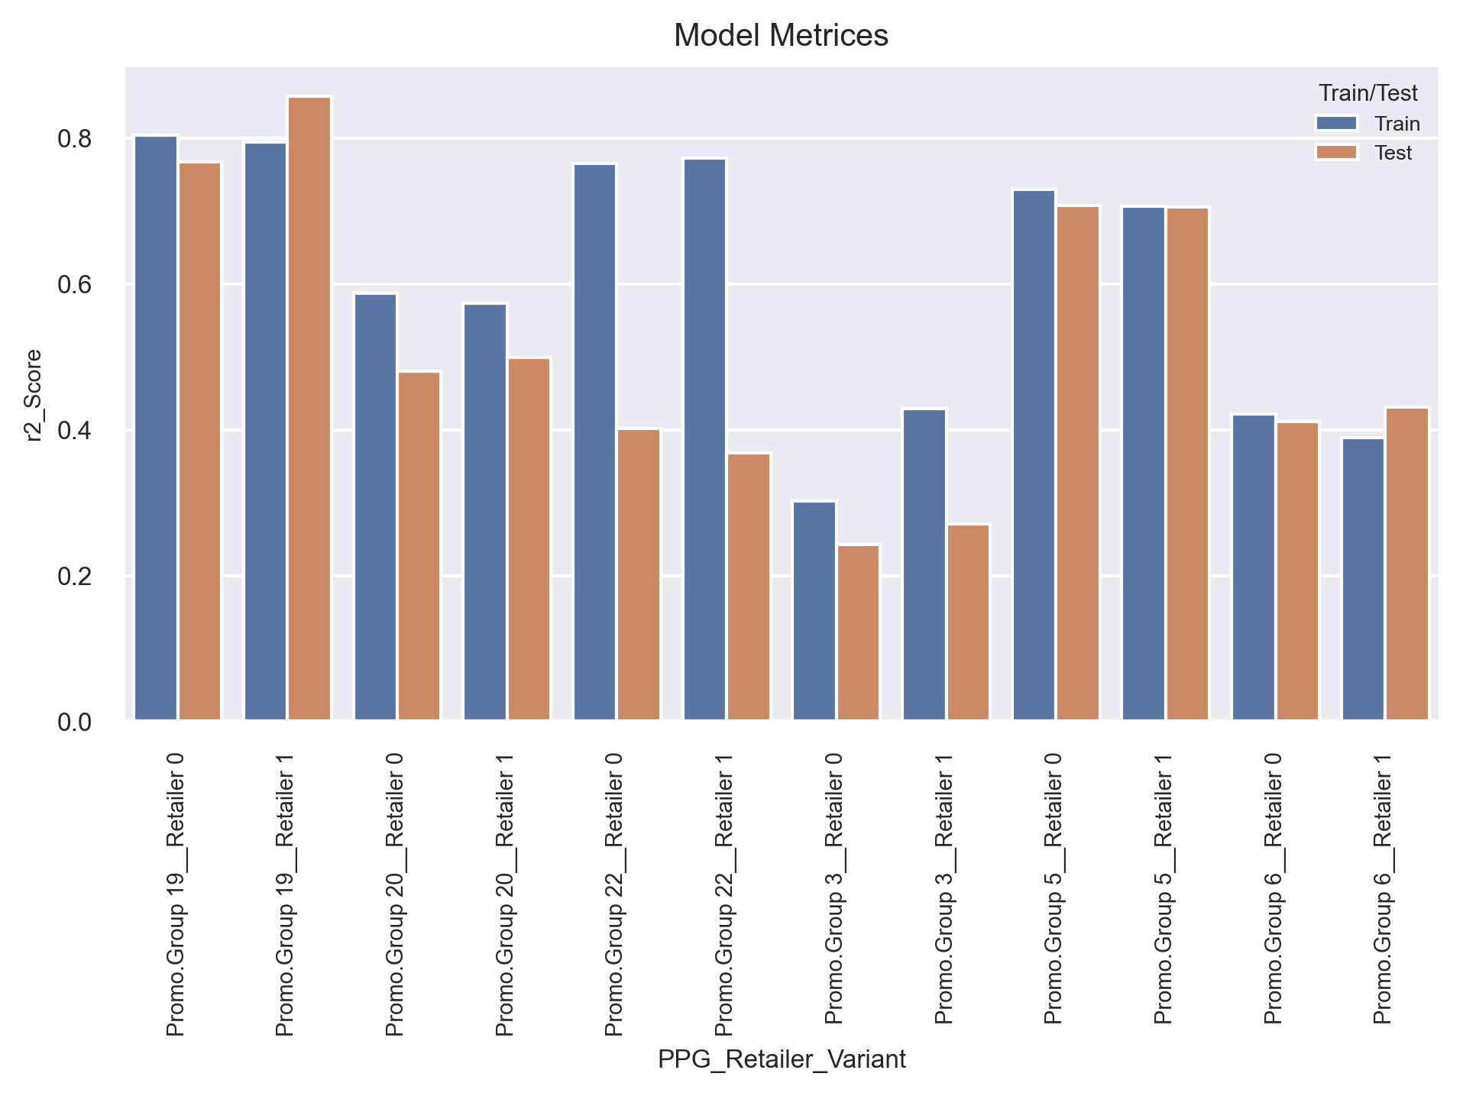
Metrics of the best models
Insights
｜
R2 score appears comparable between the training and test datasets for most models, indicating the absence of overfitting. However, overfitting is observed in Promo.Group 22 due to the limited number of available records for training

Slide 20
03
Model Interpretability

Slide 21
Interpretability & Sales Decomposition
Objective: Model Coefficients, Top Features, Decomposition of sales (Vol.Sales) into various promotional activities and other explanatory variables

Slide 22
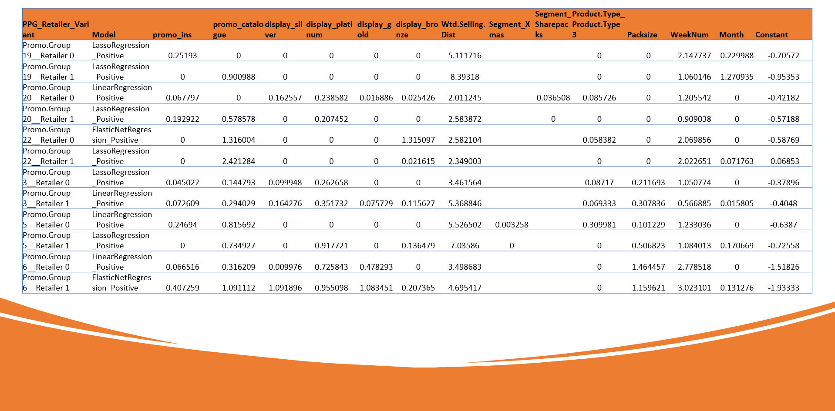
Weights and biases of best models

Slide 23
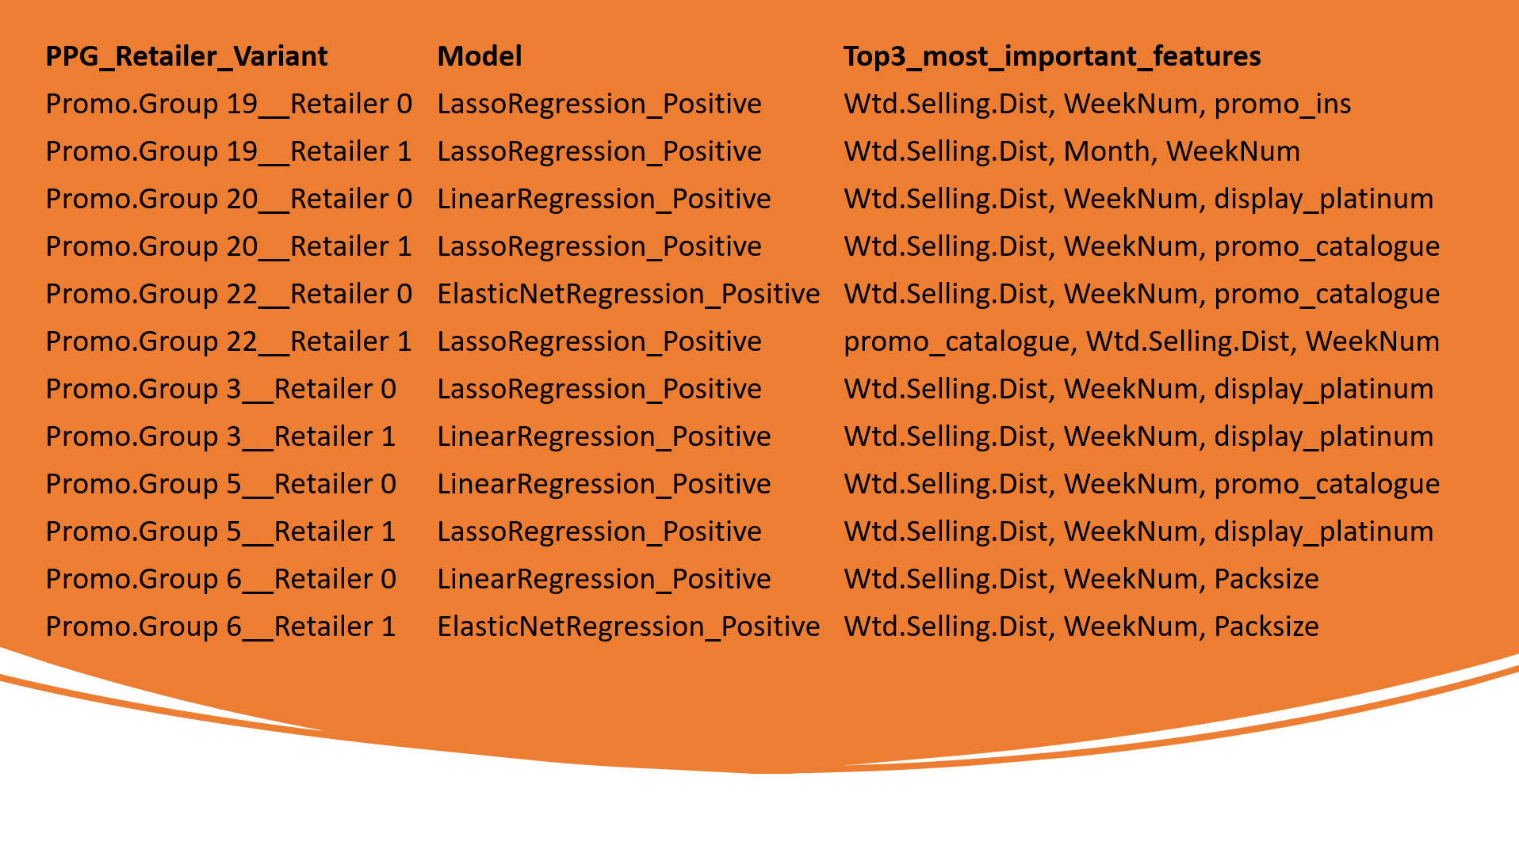
Top features of best models

Slide 24
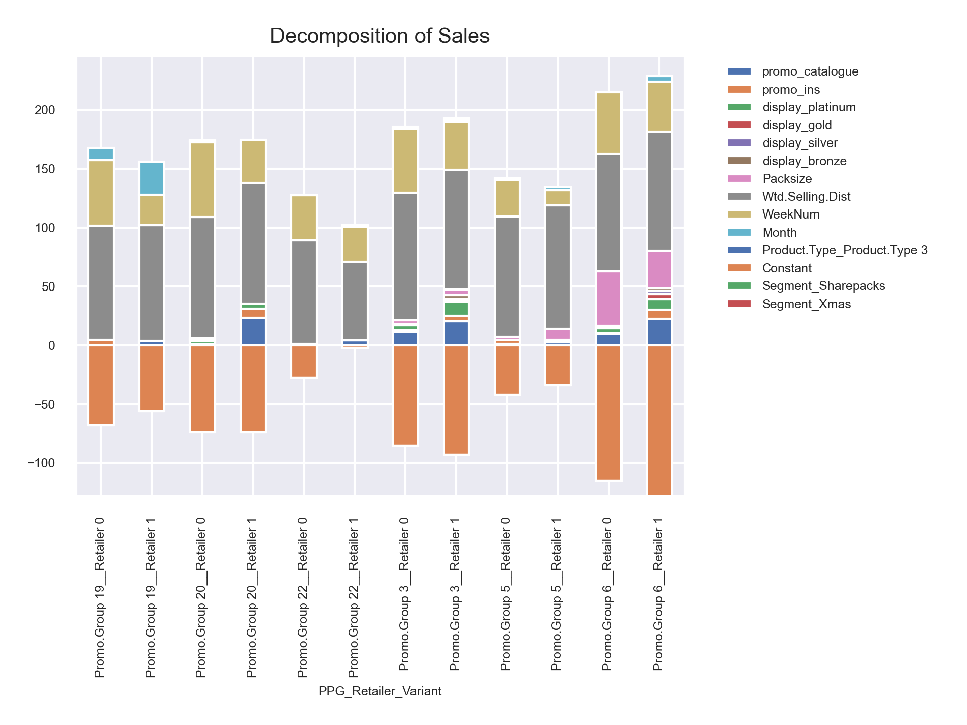
Sales decomposition of best models
Insights
｜
Contribution of explanatory variables towards the sales. This plot is consolidation of sales decomposition of all the 12 variants. Clearly ‘Wtd.Selling.Dist’ is the most important feature across all the data variants and models, followed by ‘WeekNum’ variable

Slide 26
Thank You
Do you have any questions?
Upasana Saha
upasana.saha@tigeranalytics.com
Md Fazil
md.fazil@tigeranalytics.com

